Slide 1
Chapter One
Who Needs a Database?

Slide 2
Database Overview
A database is a set of related data.
An old style library catalog, a rolodex, or an address book are databases.
Usually we use database to refer to electronic databases.

Slide 3
Flat File Databases
The simplest electronic database structures are flat file structure.
Flat file means that the data is stored in a single file.
These files can be
Delimited
Fixed length
In a spreadsheet application

Slide 4
Delimited
In a delimited file each piece of data is separated from the others by a delimiter, such as a comma or a semicolon.
Delimited files are commonly used to transfer data from one data source to another.

Slide 5
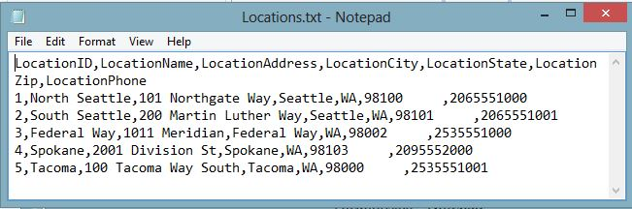
Example: Comma Delimited File

Slide 6
Fixed Length Files
In fixed length each piece of data is allotted a particular length in characters.
All fields have the same length.

Slide 7
Spreadsheets
Spreadsheets such as Microsoft’s Excel provide a more sophisticated form of flat file database.
Spreadsheets often contain additional database tools to help sort and filter data.

Slide 8
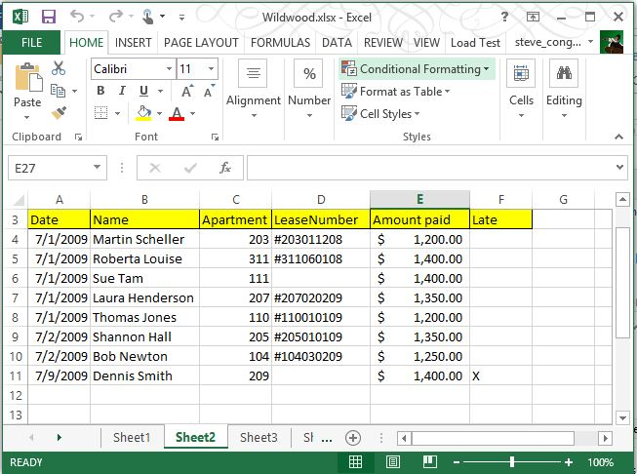
Spreadsheet Example

Slide 9
Disadvantages of Flat File Databases
Difficult to query and find information
Data redundancy – information is repeated and can be inconsistent
Difficult to compare data across files

Slide 10
Hierarchical Databases
Hierarchical databases are organized in a tree-like structure
In it one parent table can have many child tables, but no child table can have more than one parent
One analogy is the file system in an operating system like Windows

Slide 11
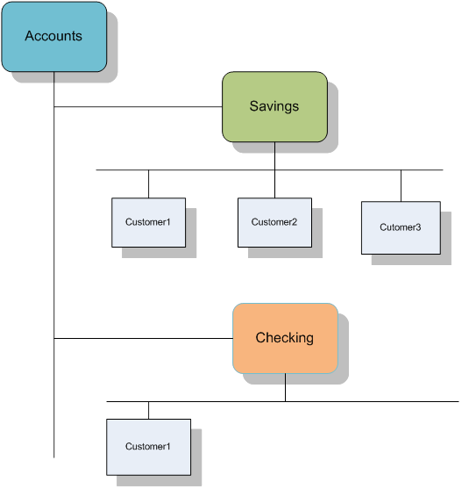
Diagram of a Hierarchical Database

Slide 12
Hierarchical Advantages and Disadvantages
Advantages
Disadvantages
Easy to navigate and understand
Fast to process
Data redundancy
Difficult to compare data between branches

Slide 13
Relational Databases
Relational databases were designed to solve the problems with flat files and hierarchical databases.
The idea for relational databases was developed by Edgar F. Codd at IBM in 1970.
He based the relational design on set theory and predicate logic.

Slide 14
Codd’s 12 Rules
Codd formulated the principles of relational databases in a document called “Codd’s 12 Rules.”
There are actually 13 rules because they begin with 0.
These rules can be found at http://en.wikipedia.org/wiki/Codd's_12_rules.

Slide 15
Nature of Relational Databases
All data, even data about data, such as a table and column names, are stored in tables.
Each row in a table should have a column (or columns) that uniquely identifies it, a primary key.
This primary key is repeated in other tables to create a relationship.
When it is repeated, it is known as a foreign key.

Slide 16
Related Tables
CustomerID(PK) | LastName | FirstName | Address | City | State
C41098X3 | Carson | Lewis | 121 Center Street | Seattle | WA
CV1099B1 | Madison | Sarah | 1324 Broadway | Seattle | WA
D345XU24 | Brown | Lisa | 2201 Second Ave | Seattle | WA
TransactionID | TransactionType | TransactionDate | CustomerID(FK) | Amount
10002345 | Deposit | 2009-2-12 10:25:06 | C41098X3 | 1245.76
10002346 | Deposit | 2009-2-12 10:27:13 | CV1099B1 | 500.00
10002347 | Withdrawal | 2009-2-13-14:45:57 | C41098X3 | 200.00

Slide 17
SQL
Codd said that a relational database should have a sublanguage that can manage all data manipulations, as well as DBMS processes such as security and backup.
SQL has become that language.

Slide 18
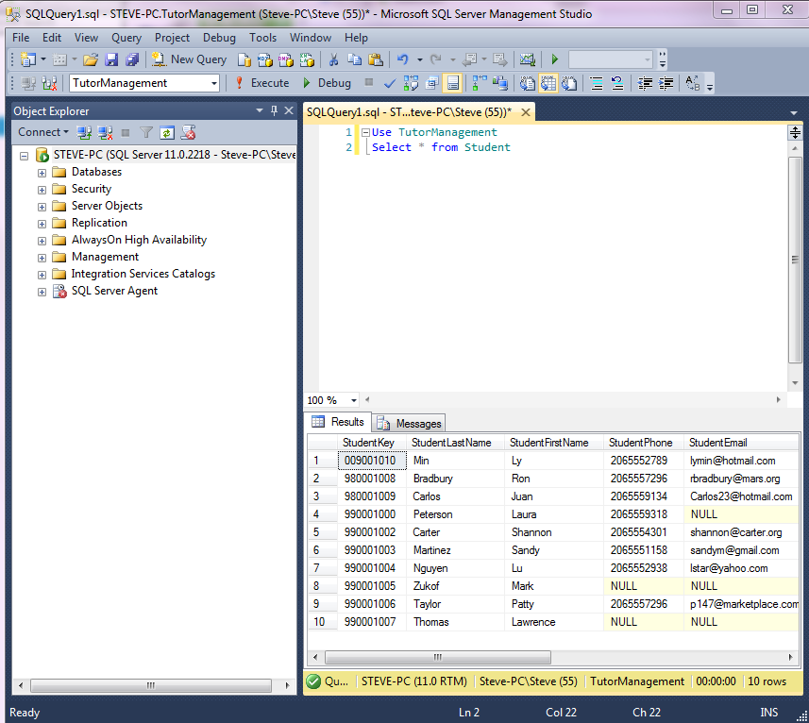
Example SQL Query

Slide 19
Relational Database Management Systems (RDMS)
An RDMS is software that manages relational databases.
It must allow for the creation and maintenance of databases.
It usually has tools for backup and restoring databases.
It usually has tools for securing access to database objects.
It may have many other administrative and reporting tools.

Slide 20
Table of Popular DBMSs
RDBMS | Comments | URL
ORACLE | The first commercial RDMS and the biggest. Powers many of the world’s largest companies | http://www.Oracle.com
SQL Server | Microsoft’s RDMS product. Ships in many versions designed for different company needs. Also powers many large enterprises | http://www.microsoft.com/sql/default.mspx
DB2 | IBMs RDBMS | http://www306.ibm.com/software/data/db2/9/
MySQL | The most popular Open Source RDBMS currently owned by SUN | http://www.MySql.com
PostGres SQL | Another free, Open source RDBMS. It is older and some would say more powerful than MySQL | http://www.postgresql.org/
ACCESS | Microsoft’s Desktop Database | http://office.microsoft.com/en-us/access/default.aspx?ofcresset=1

Slide 21
Opportunities for Database Development
Many small businesses and nonprofits have outgrown storing their data on paper or in spreadsheets.
They have too much data to handle manually.
They need to retrieve information quickly.
They need to compare different pieces of information.

Slide 22
Initial Interview
The goal of the initial interview is to get the broad scope of the database project.
Always prepare for an interview.
Have questions ready that help those being interviewed focus on the important questions.
Don’t guide them toward any preconceived notions of the database.
Your task is to understand their needs.

Slide 23
Identifying the Big Topics
Review all your materials and identify the nouns.
See if the nouns cluster into themes, that is, if several of them relate to the same general subjects, such as “customer” or “sale.”
These themes will probably become “Entities” in your database.

Slide 24
Statement of Work
Once you have an overview and have agreed to the project, you can work on a statement of work.
The client may prepare one for you or you may need to prepare one. It is important to put these initial expectations in writing.
A statement of work consists minimally of
A history
A scope
Objectives
Tasks and timeline

Slide 25
History
The history is the review of the problem the database is meant to solve.
It may detail how data was handled previously.
Why the method is no longer acceptable.
It may also list the steps that led to the decision to begin the new project (reviews, consultants, etc.).

Slide 26
Scope
The scope provides the range of the project.
Without getting into specifics, it should list all the broad requirements of the project.
It may also list constraints, things the project will not include.
The scope provides an important touchstone as the project proceeds. Everyone can refer back to it and ask whether this element belongs to the scope of this project or not.

Slide 27
Objectives
Stating objectives can be useful to keep clear what the purpose of the project is.
The scope lists what will be included in the project; the objectives list why they are in the project.
Ideally they are things that can be verified so that one can say yes, this is done, or no, this isn’t finished yet.

Slide 28
Tasks and Timeline
Although it is at a very early stage in the development process, it is good to set a preliminary timeline and to define the tasks that should be accomplished within those times.
It forces everyone to think through the process and define what steps are involved.

Slide 29
Estimating Times
It is very difficult to estimate times until you have a fair amount of experience.
One strategy is to think about how long the task would take you if everything went right.
Next think about how long it would take you if everything went wrong.
Thirdly, estimate how long you think it will probably take and then move it a bit toward the worst case estimate.

Slide 30
Documentation
Documentation is essential to the development process.
With a database there are two main things that need to be documented:
The structure of the database itself
The process by which the database was developed
You should keep a notebook that stores all related documents and that records all relevant decisions regarding the database.

Slide 31

All rights reserved. No part of this publication may be reproduced, stored in a retrieval system, or transmitted, in any form or by any means, electronic, mechanical, photocopying, recording, or otherwise, without the prior written permission of the publisher. Printed in the United States of America.

